Slide 1
Task 3 - Shiny app
In the keyword search box, user can enter 5 – 20 words long. The app get the input and o go into the corpus, sentence-tokenize it and fish out sentences that contain any of the keywords in the list. Collate all these keyword-matched sentences into a new 'keyword-filtered' corpus as your first output. Display the relative frequencies of the occurrence of the keywords in your corpus as a bar-chart and as a word cloud
Team:
Soujanya Kunapareddy: 11920063
Chitra Periya: 11920091
Tamilselvan: 11920024
Arun Manohar Kallepalli: 11920032
Vamshi Krishna Bolloju: 11920065

Slide 2
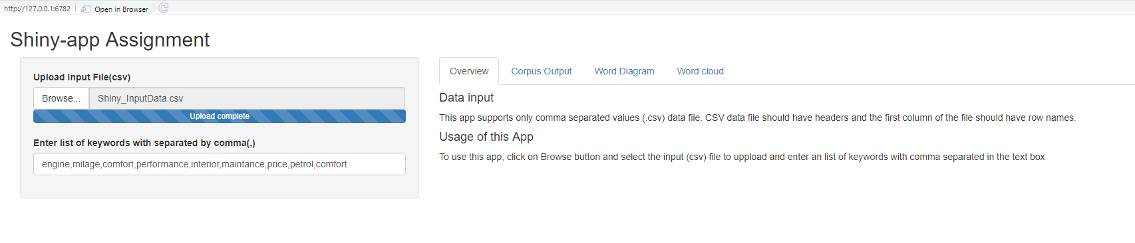
Output

Slide 3
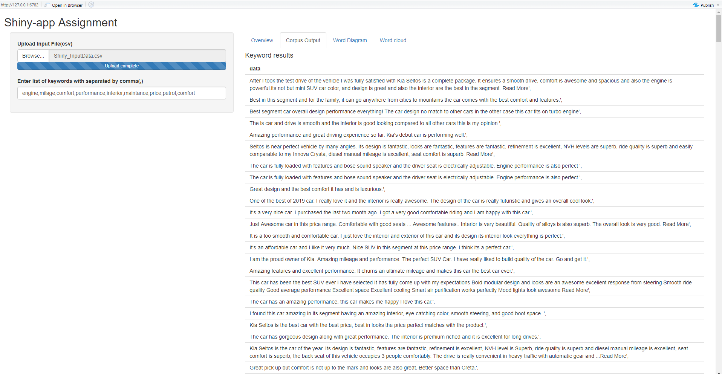

Slide 4
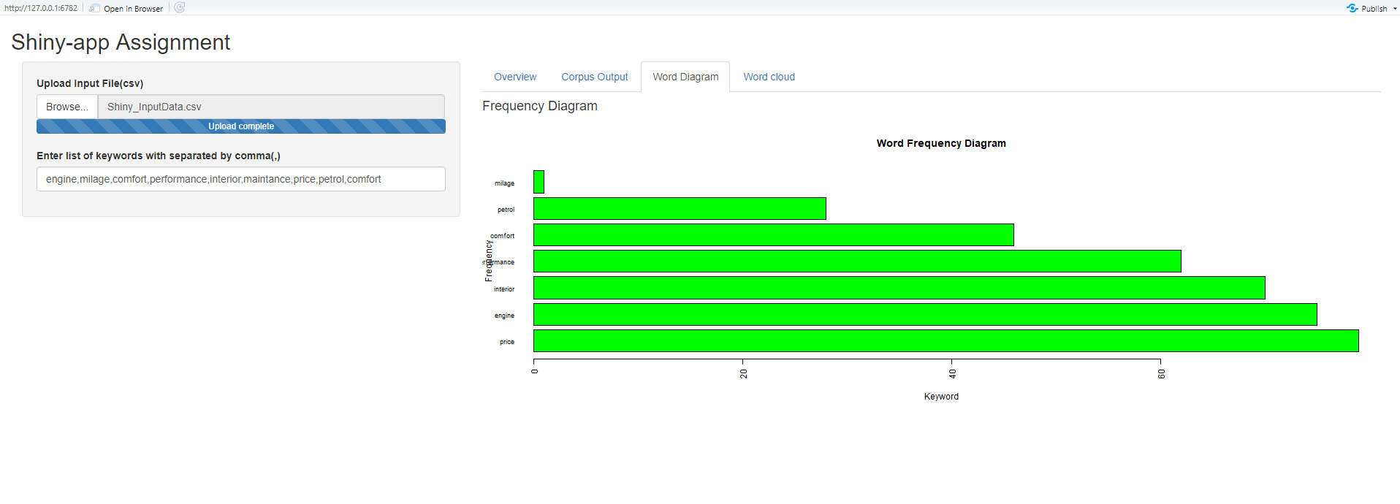

Slide 5
